Slide 1


8085 Microprocessor
Presented by
Mahbubur Rahman
Lecturer
Department of Computer Science and Engineering(CSE)
Green University of Bangladesh(GUB)

Slide 2
Outline
02
Overview of Microprocessor
8085 Microprocessor
8085 Microprocessor Flag Register
8085 Microprocessor Architecture

Slide 3
Overview
03

Slide 4
Microprocessor
04
Microprocessor is a programmable device.
It can be instructed to perform given tasks within its capability.
The programmer selects instruction from the list and determines the sequence of execution for a given task.
It takes input from the input device and process the input like a CPU and gives the output.
Microprocessor can be divided into three segments – ALU, Register Array, Control Unit.

Slide 5
Characteristics which differentiate μP
05
Instruction Set: The set of instructions that the microprocessor can execute.
Bandwidth: The number of bits processed in a single instruction.
Clock Speed: Given in (MHz), the clock speed determines how many instructions per second the processor can execute.

Slide 6
What is the difference between μP, μC and μ-computer?
06
A Microcontroller is a Microcomputer with memory and I/O integrated into one chip.
The Microcomputer is a Microprocessor with added memory and input/output
The Microprocessor contains the CPU, the ALU and the control units, with partial memory and I/O configuration.

Slide 7
What is a bit, byte, nibble and a word?
07
Eight bits represent a character and is called a byte.
Nibble: A nibble is a combination of four bits, in other words a nibble is half a byte.
Word: a word is a combination of 16 bits, 32 bits or 64 bits depending on the computer.

Slide 8
What is Mnemonics?
08
Assembly language is the symbolic form of machine language. Assembly programs are written with short abbreviations called mnemonics.
Assembly language uses a mnemonic to represent each low-level machine instruction or opcode.
Mnemonic is anything (especially something in verbal form) used to help remember something while opcode is (computing) a mnemonic used to refer to a microprocessor instruction in assembly language.

Slide 9
Definition of a Microprocessor
09
The microprocessor is a programmable device that takes in numbers, performs on them arithmetic or logical operations according to the program stored in memory and then produces other numbers as a result.

Slide 10
Microprocessor
10
Input
Output
Microprocessor
Memory

Slide 11
Inside the Microprocessor(1/2)
11
Internally, the microprocessor is made up of 3 main units.
The Arithmetic/Logic Unit (ALU).
The Control Unit.
An array of registers for holding data while it is being manipulated.
I/O
Input / Output
ALU
Register
Array
System Bus
Control
Memory
-------------------------------
ROM RAM

Slide 12
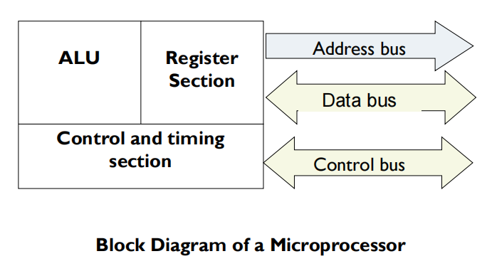
Inside the Microprocessor(2/2)
12

Slide 13
8085 Microprocessor
13

Slide 14
8085 Microprocessor
14
The 8085 microprocessor was introduced by Intel in the year 1977.
It has 16-bit address bus and 8-bit data bus.
This microprocessor is an update of 8080 microprocessor.
It is an 8-bit microprocessor with a 40 pin Dual in Line Package (DIP)
It is used in washing machines, microwave ovens, mobile phones, etc.

Slide 15
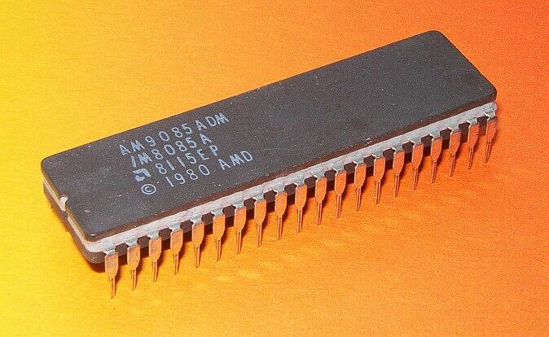
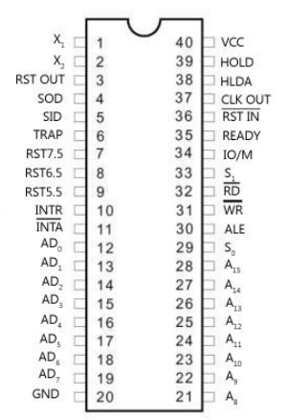
8085 Microprocessor chip
15
8-Bit 8085 Intel Processor (Pin Diagram)

Slide 16
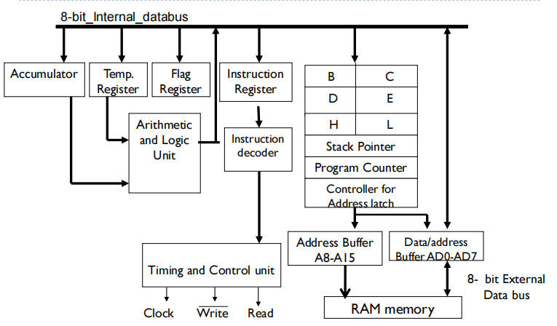
8-Bit 8085 Intel Processor Architecture
16

Slide 17
8085 Microprocessor Configuration
17
8-bit data bus
16-bit address bus
16-bit program counter
16-bit stack pointer
Six 8-bit registers arranged in pairs: BC, DE, HL
Requires +5V supply to operate at 3 or 3.2 MHZ single phase clock

Slide 18
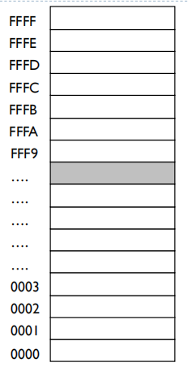
8085 Registers
18
Total 11 registers and 1 temporary register
Information is stored in registers
Registers are classified according to the functions they perform
64 Kbytes of memory and 65536 memory locations.

Slide 19
8085 Register Categories
19
Accumulator: 8 bit register which holds the latest result from ALU
B, C, D, E, H and L are general purpose registers. HL pair can be used for indirect addressing as well
Program counter(PC): 16 bit register which holds the address of the next instruction to be executed
Instruction Register(IR): It holds the instruction that is currently being processed.
Stack Pointer(SP) is used during subroutine calling and execution.
Address Latch: It increments/ decrements the address before sent to the address buffer

Slide 20
8085 Microprocessor
Flag Register
20

Slide 21
8085 Flag Register
21
In 8085 microprocessor, the flags register can have a total of eight flags. Thus a flag can be represented by 1 bit of information. But only five flags are implemented in 8085. And they are:
Carry flag (Cy),
Auxiliary carry flag (AC),
Sign flag (S),
Parity flag (P), and
Zero flag (Z).

Slide 22
8085 Flag Register
22
In 8085 microprocessor, the flags register can have a total of eight flags. Thus a flag can be represented by 1 bit of information. But only five flags are implemented in 8085. And they are:
Carry flag (Cy),
Auxiliary carry flag (AC),
Sign flag (S),
Parity flag (P), and
Zero flag (Z).
These individual flags are either set to 1, or reset to 0 depending on the result of execution of the last executed arithmetic or logical instruction. But in a few arithmetic and logical instructions, some or none of these flags are affected.

Slide 23
8085 Flag Register
23
Sign Flag: If the result of the latest arithmetic operation is having MSB (most- significant byte) ‘1’ (meaning it is a negative number), then the sign flag is set to ‘1’. Otherwise, it is reset to ‘0’ which means it is a positive number.
Zero Flag: If the result of the latest operation is zero, then zero flag will be set to ‘1’; otherwise it be reset to ‘0’.
Carry Flag: After performing the addition of any two 8-bit numbers, If the result of the latest operations exceeds 8-bits then this flag will be set to ‘1’. Otherwise, it is reset to ‘0’.

Slide 24
8085 Flag Register
24
Auxiliary Carry Flag: This flag is not accessible to programmer. This flag will be used by the system during BCD (binary-coded decimal) operations. Now let us consider the addition of any two 8-bit (2-hex digit) numbers, a carry may be generated when we add the 1st hex digits of the two numbers. Such a carry is called intermediate carry also known as half carry, or auxiliary carry (AC).
Parity Flag: If the result of the latest operation is having even number of ‘1’s, then this flag will be set to ‘1’ Otherwise this will be reset to ‘0’. This is used for error checking.

Slide 25
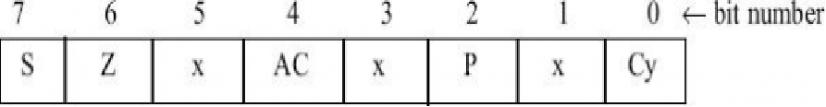
8085 Flag Register
25
The respective position of these flag bits in flag register has been show the below figure. The positions marked by “x” are to be considered as don't care bits in the flags register.

Slide 26
8085 Flag Register
26
Example output:
Bit Number | 7 | 6 | 5 | 4 | 3 | 2 | 1 | 0
Flag Values | 0 | 1 | x | 0 | x | 1 | x | 1
 | S | Z |  | AC |  | P |  | Cy

Slide 27
Example 01
27
In the addition of 45H and F3H, the result thus produced will be 38H. Show the flag values.
45h = 0100 0101
F3h = 1111 0011
------------------------------------------
Output = 1 0011 1000
Cy = 1, because of carry.
AC = 0, no intermediate carry
S = 0, MSB = 0
Z = 0, Output not zero
P = 0, total 3 1’s.

Slide 28
Example 02
28
In the addition of 85H and 1EH, the result produced will be A3H. Show the flag values.
85h = 1000 0101
1Eh = 0001 1110
------------------------------------------
Output = 0 1010 0011
Cy = 0
AC = 1
S = 1
Z = 0
P = 1

Slide 29
Exercise: 01
29
Addition of BC and DE
Task: Derive the flag values
Notes:
S = 1, z = 0, p =1, cy = 1, ac = 1

Slide 30
Exercise: 02
30
MVI A, 32H
MVI B , 48H
ADD B
OUT 01H
HLT
Task: Derive the flag values

Slide 31
8085 Microprocessor
Architecture
31

Slide 32
8085 μP
32
It is an 8-bit microprocessor.
40 pin IC
16-bit address bus and 8-bit data bus.
This microprocessor is an appended version of 8080 microprocessor.
Power supply 5v
Operating frequency 3 MHz
Maximum Memory attached to 8085 microprocessor is 64KB

Slide 33
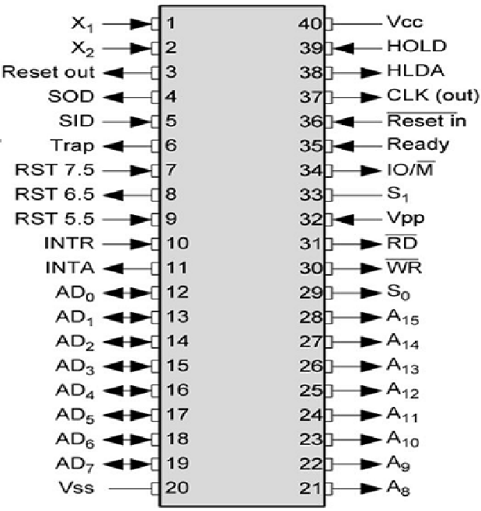
8085 Pin Diagram
33

Slide 34
5 Categories
34
Address and Data Bus.
Control and Status Signal
Interrupts & externally initiated signals
Serial Input Output
Power and Clock Pins.

Slide 35
Address and Data Bus
35
Data bus (8 bit): represents the bit of μP.
Address bus (16 bit): represents maximum memory that can be interfaced to μP.
Total address space: 2¹⁶ = 2⁶ X 2¹⁰ = 64 X 1024 = 64K Bytes.
AD7 - AD0 depends on ALE pin. (DEMUX)
If ALE = 1, A7 - A0
If ALE = 0, D7 - D0

Slide 36
Control and Status Signal (1/2)
36
These signals are used to identify the nature of operation. There are 3 control signal and 3 status signals. Three status signals are IO/M’, S0 & S1.
IO/M’:
If 1, Input/Output device will be enabled
If 0, Memory device will be enabled
S1 & S0: Status of the operation of microprocessor

Slide 37
Control and Status Signal (2/2)
37
Three control signals are RD’, WR’ & ALE.
RD’:
If 0, Read Operation will be enabled
If 1, Read Operation will be disabled
WR’:
If 0, Write Operation will be enabled
If 1, Write Operation will be disabled
ALE:
If ALE = 1, A7 - A0 (Address bus will be selected)
If ALE = 0, D7 - D0 (Data bus will be selected)

Slide 38
Interrupts & externally initiated signals (1/3)
38
Interrupts are the signals generated by external devices to request the microprocessor to perform a task. There are 5 hardware interrupt signals, i.e. TRAP, RST 7.5, RST 6.5, RST 5.5, and INTR.
Hardware interrupts: through pin.
Software interrupts: through instructions.
Priority: TRAP > RST 7.5 > RST 6.5 > RST 5.5 > INTR

Slide 39
Interrupts & externally initiated signals (2/3)
39
INTA’: It is an interrupt acknowledgment signal. (only for INTR)
RESET IN’: This signal is used to reset the μP by setting the program counter to zero.
RESET OUT: This signal is used to reset all the connected devices when the μP is reset.
READY: This signal indicates that the device is ready to send or receive data. It is used to synchronize with the slow peripherals

Slide 40
Interrupts & externally initiated signals (2/3)
40
HOLD: This signal indicates that another master (DMA) is requesting the use of the address and data buses.
HLDA(HOLD Acknowledge): It indicates that the CPU has received the HOLD request. HLDA is set to low after the HOLD signal is removed.
HOLD has higher priority than TRAP.

Slide 41
Serial Input Output
41
There are 2 serial signals, i.e. SID and SOD and these signals are used for serial communication.
SOD (Serial output data line): The output SOD is set/reset as specified by the SIM instruction.
SID (Serial input data line): The data on this line is loaded into accumulator whenever a RIM instruction is executed.

Slide 42
Power and Clock Pins
42
Vcc: Vcc indicates +5v power supply.
Vss: Vss indicates ground signal.
X₁ , X₂ : A crystal oscillator is connected at these two pins and is used to set frequency of the internal clock generator. This frequency is internally divided by 2. So the frequency of the oscillator is 6 MHz.
CLK OUT: This signal is used as the system clock for peripherals connected with the microprocessor.

Slide 43
8085 Instructions
43
Data Moving Instructions:
Control Instructions: Conditional, Unconditional, Call subroutine, Return from subroutine and Restarts.
Logical Instructions: AND, OR, XOR and Rotate.
Arithmetic Instructions :Add, Subtract, Increment and Decrement.
Input/Output Instructions:
Others: Setting/Clearing flag bits, enabling/Disabling interrupts, Stack operations etc.

Slide 44
Thank You
44

